Slide 1
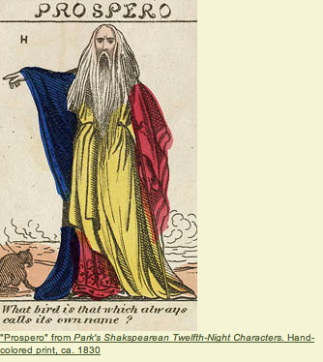
THE TEMPEST
Act One Scene Two, Lines 46-208

Slide 2
OBJECTIVES
Character Study
The difference between subjective and objective point of view
Decode Shakespeare's language
Interpret the play through movement and gesture.

Slide 3
Act One Scene Two, Lines 46-208
Read through Prospero's telling the story of his overthrow to Miranda, 1.2.46-208.
Focus on the stated and implied reasons for his overthrow, and take notes on these reasons

Slide 4
What is the difference?
between objective and subjective …
What is a spin doctor?

Slide 5
objective (fair; presented factually; uninfluenced by emotions or personal prejudices)
subjective (influenced by emotions or personal experiences; expressing the individuality of the artist or author).
A spin doctor, a person whose job is to frame remarks by favouring one side—a propagandist.

Slide 6
Group Work
Divide into three groups.
Group A will present Prospero's story as objective news reporters;
Group B will act as spin doctors who emphasize Prospero's innocence and Antonio's crime;
Group C will act as spin doctors who emphasize Prospero's neglectful leadership and Antonio as Milan's savior.

Slide 7
Presentation
Write and present a Breaking News Report:
Look back at your work on text type and remember to begin with a What/Where/When/Why
Think carefully about the language that you use…
Involve everyone in your news report – eye witnesses/characters/improvised scene etc
Video your news report….

Slide 8
Discussion
Did you present three reports that conveyed different opinions about the action?
Did this activity change your opinions about Prospero at all?
Do you feel that one of these interpretations is "most correct"?
Are you able to see many possible interpretations of Prospero available to actors through Shakespeare's text?

