Slide 1
CLOWN PUNK
SIMON ARMITAGE

Slide 3
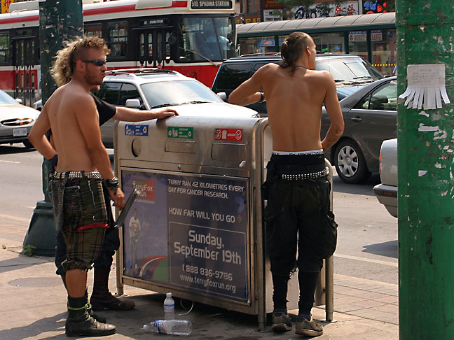
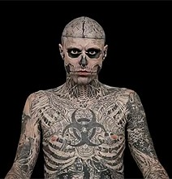
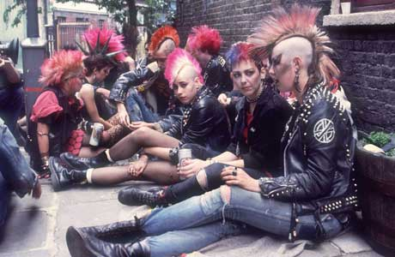
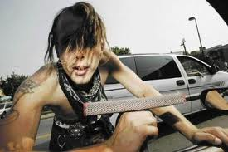
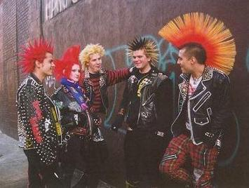
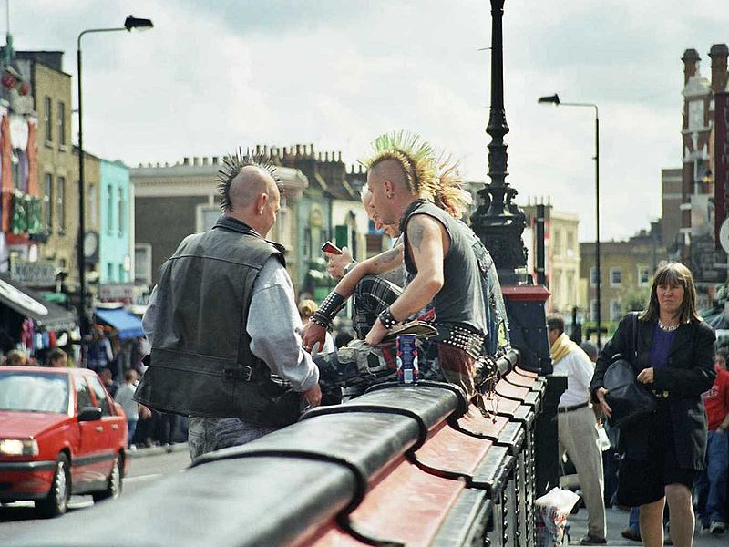

Slide 4
Driving home through the shonky side of town,
Three times out of ten you’ll see the town clown,
Like a basket of washing that got up
And walked, towing a dog on a rope. But
Don’t laugh: every pixel of that man’s skin
Is shot through with indelible ink:
As he steps out at the traffic lights,
Think what he’ll look like in thirty years’ time –
The deflated face and shrunken scalp
Still daubed with the sad tattoos of high punk.
You kids in the back seat who wince and scream
When he slathers his daft mush on the windscreen,
Remember the clown punk with his dyed brain,
Then picture windscreen wipers, and let it rain.

Slide 5
Simple Summary
A man driving home through the rundown (shonky) side of town with his children in the backseat sees a heavily tattooed homeless man. The children wince at the sight of the vagrant when he tries to wash the windscreen of the car in the hope of making a few pence. The father tells the children to remember the 'clown punk' although his reason is unclear.
The philosophical tone of the poem would suggest that the speaker wants his children to look past the decay of the clown punk and see his inner tragedy and humanity. The image of the windscreen wipers and rain in the final rhyming couplet suggests a washing away of the past, or a sense of renewal or cleansing. The ambiguous ending of the poem is typical of an autobiographical poem where the poet is writing from memory.

Slide 6
Subject
The poem describes an encounter with the eponymous Clown Punk, a tattooed, slightly tragic character who presses his face against the windscreen of the narrator's car when it stops at traffic lights, frightening the children sitting in the back seat.
Armitage told a BBC website interviewer in 2006 that this poem is based on a real person he used to see around town, and follows "a tradition in English Literature of writing such poems, where one type of person stands eyeball to eyeball with another type, and something passes between them”.

Slide 7
structure
The poem consists of a single stanza of 24 lines. The lines are pentameters (they have ten syllables each).
The poem the the form of sonnet – a poem of 14 lines usually written in iambic pentameter, with a clear rhyme scheme. Armitage plays with the form for effect.
Look carefully at the last line of the poem. The only full rhyme in the poem is ‘brain’ and ‘rain’ at the end. Why are these two words connected here?
How does each word in the last line connect with the rest of the poen?
‘Let it rain’ is a command, and the last three words of the poem. What effect does this have?

Slide 8
Sound
Some of the vocabulary is very 'northern' - the phrase “slathers his daft mush” is particularly suggestive of Armitage's Yorkshire roots.
Can you find any more examples?
The rhyme in the phrase “"town clown"” contributes to the creation of a comic image, before telling us not to laugh.

Slide 10
Imagery
“shonky” is a term for the word ghetto or the “bad side” of town. That part of town where the poorest of the poor live.. That life represented by the town clown. A clown being something that is meant to be made fun of. It asks for attention. Like many of the masses who simply think homeless people who live in lower socioeconomic portions of the town made the choice to live the life that they do. Not only have they asked for it, but they look it too.
The simile of “a basket of washing that got up and walked, towing a dog on a rope” conjures a shambolic person. The clown is “like a basket of washing. . .” is a unique way to say dirty. A “basket of washing” being full of dirt and grime mixed in with water. Yet, this bucket of dirty water, this “basket of washing” walks and even goes as far as to tow a dog on a rope. The structure of the sentence mirrors the way the dog walks behind the clown punk.

Slide 11
Armitage makes the reader re-imagine a heavily tattooed body. The man's skin is an image all of its own, made up of “"every pixel"”. But the poem stops us from reacting with fear, as we might typically; instead we are encouraged to think sympathetically of how such a person will look in old age, when the tattoos become “"sad"”.
Vocabulary to do with art or painting - “"ink"”, “"daubed"” and “"dyed"” - permeates the poem in the same way that tattoos puncture the man's skin, so that the ink has sunk even into his “"brain”. Permanent and everlasting. This meaning that whatever it is that has happened to this individual, is thick, dark, and everlasting. It can’t be erased. This is a nice reflection of the washing bucket as you see the connection of being a washing bucket, but having a situation that can’t simply be washed away. From here, the description becomes rather concrete. Is there a pun here with 'died'?
It is striking that although the tattoo ink is “"indelible"”, the image of the clown punk can be washed away with windscreen wipers and rain in the minds of the children on the back seat. Although tattoos are permanent, people are not, so eventually everything will be gone.

Slide 12
“The deflated face and shrunken scalp.” A tangible and comprehensible image. Though, it moves on to the use of the word daft which can mean foolish and insane. A clown can be quite foolish and children are often traumatized by clowns. The insanity aspect of this clown is further perpetuated by the image of the “dyed brain”. This referring to almost a brain that is rainbow like in nature or even tie-dye. This word choice also implies and brings up images of beatnik hippies or punks who do hard drugs. Drugs also being prevalent in these rougher spots of larger cities in the “shonky side['s] of town”.
The poem ends with the windscreen and the rain. This represents the washing away of this image seen by the children while driving through this portion of town and coming across the clown.

Slide 13
Attitudes, themes and ideas
The Clown Punk is a character who could be either frightening or comic, but the narrator warns, “"don't laugh"”. Instead the poem creates a pathetic figure, who will be “"deflated"” by the years. There is an almost dismissive tone to the poem, suggested in descriptive phrases like “"basket of washing"” and “"daft mush"”, perhaps used to make the punk seem less threatening to the children in the car.
As he often does, Armitage is introducing us to a character that we might not normally look at so closely. The clown punk is a shambles, someone we would try to avoid or might mock. But Armitage makes us see him in another light and perhaps pity him.

Slide 14
Armitage encourages the reader to interact in three very specific ways.
“Don’t laugh:”. The reader is forced to pause and to reflect with the presence of the colon. Don’t laugh at this clown who is representing a person living in poverty and in a section of town structurally stratified by political legislation. This man’s skin is engraved with permanent tattoos (Life experiences.) These experiences of living in a system that structurally creates impoverished areas, “shonky” sides of towns, are permanent. They can not be washed away. So, don’t laugh.
Think about what thirty more years of living in this part of town will do to this dirty looking person. Their face is already severed and broken. They are already a bucket of washing water. But, what will this person look like in thirty more years?.
Remember this fool. Remember this clown and this terrifying incident. Poverty, structural racism in inner cities is ignored, overlooked, and simply washed away by the “windscreen wipers” that move back and forth in the rain.

Slide 15
The author is asking readers to take another view of these parts of town. To reconsider the why of the situation. Why is it that this part of town even exists? Why are there these clowns who occupy this “shonky” side of town?
The author, through this short narrative poem asks readers to confront a larger question about poverty and inequality by providing a concrete image and asking people to reflect on the metaphorical representations provided. By doing this, we can confront and possibly change the circumstances of not only our terrified children, but the existence of “punk clowns” themselves.

Slide 17
Comparison
Give
Each of the main characters in these two poems is someone who is not a part of conventional society: Armitage brings us face to face with them.
Both characters make a scene by getting too close to an audience.
The character in The Clown Punk doesn't get to speak to us, unlike the main character in Give: what difference does this make for the reader?
Horse Whisperer
Both poems bring us face to face with an unusual character and let us learn something about them.
There is a focus on physical detail in both poems - although in Horse Whisperer it is about horses, rather than a human character.
There is the suggestion of a change over time, in the main characters of both poems.

Slide 18
Question
How is the character presented in The Clown Punk?
Answer
Armitage uses strong images to create a visual picture of the character, comparing him to a “"basket of washing"”.
Adjectives like “"deflated"”, “"shrunken"” and “"sad"” all create a sense of a character who is much less than he could be.
The contrasting reactions of the narrator and children to the Clown Punk help to create a sense of his character: the children are afraid, but the narrator is dismissive of his “"daft mush"”.
The Clown Punk is presented as faintly ridiculous: Armitage uses the rhyme of “"town clown"” to suggest this.
The tattoos go right through to the character's “"dyed brain"”, and the use of surface-art vocabulary throughout the poem suggests that the tattoos are all there is to this man.

